Slide 1
BOOTCAMP
ACE ENGINEERING COLLEGE
TOPIC : DATA INTELLIGENCE AND AI

Slide 2
Day 6: Automated Data Classification Models
1. Categorical Decisions (Classification)
What is Classification?
Classification is a supervised machine learning technique used to predict a category or class label for new data based on historical examples.
Examples
Email → Spam or Not Spam
Loan Application → Approved or Rejected
Medical Report → Disease Present or Disease Absent
Customer → Likely to Buy or Not Buy
How Classification Works
Collect labeled data.
Train a machine learning model.
Learn patterns from features.
Predict the class of new records.

Slide 3
Example Dataset
Age | Income | Purchased
25 | 30000 | No
35 | 60000 | Yes
28 | 35000 | No
45 | 80000 | Yes

Slide 4
Features and Target
Input Features:
Age
Income
Target Variable:
Purchased (Yes/No)

Slide 5
Classification algorithms
Common Classification Algorithms
Decision Tree
Random Forest
Logistic Regression
Support Vector Machine (SVM)
K-Nearest Neighbors (KNN)
Naive Bayes

Slide 6
2. Decision Tree Algorithms
What is a Decision Tree?
A Decision Tree is a machine learning model that makes decisions by repeatedly splitting data into smaller groups based on feature values.
Components
Root Node
Starting point of the tree.
Decision Node
Contains conditions used for splitting.
Leaf Node
Final prediction/class.

Slide 7
Example
Predict whether a customer will purchase a product.
Age | Income | Purchase
22 | Low | No
28 | Medium | No
35 | High | Yes
45 | High | Yes

Slide 8
Decision Tree Algorithm
Advantages
✅ Easy to understand
✅ Visual interpretation
✅ Handles numerical and categorical data
✅ Requires little data preprocessing
Disadvantages
❌ Can overfit training data
❌ Sensitive to small changes
❌ May become complex with large datasets

Slide 9
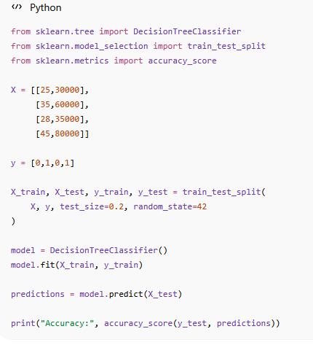
Code

Slide 10
3. Evaluating Categorical Accuracy
Confusion Matrix
A Confusion Matrix measures classification performance by comparing actual and predicted classes.
Binary Classification Example
 | Predicted Positive | Predicted Negative
Actual Positive | TP | FN
Actual Negative | FP | TN

Slide 11
Accuracy metrics
Where:
TP = True Positive
TN = True Negative
FP = False Positive
FN = False Negative

Slide 12
Example Matrix
 | Predicted Yes | Predicted No
Actual Yes | 50 | 10
Actual No | 5 | 35
Interpretation:
50 correctly predicted Yes
35 correctly predicted No
10 missed positives
5 false alarms

Slide 13
Metrics
TP = 50
TN = 35
FP = 5
FN = 10

Slide 14
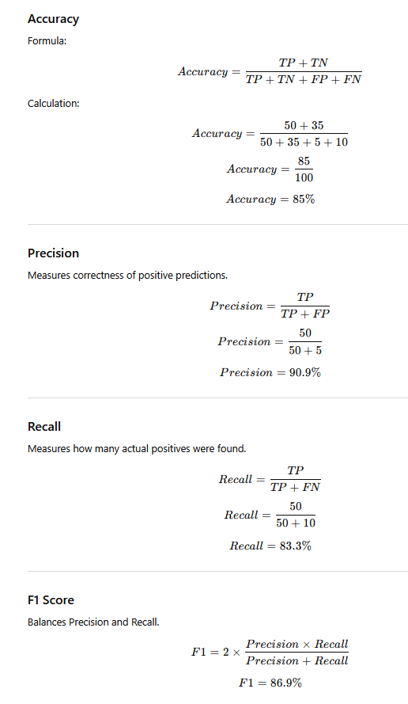
METRICS

Slide 15
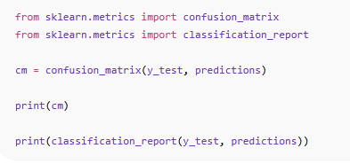
Confusion matrix

Slide 16
4. Feature Relevance Analysis
What is Feature Importance?
Feature Importance identifies which variables contribute most to model predictions.
Example Dataset
Feature | Importance
Income | 0.45
Age | 0.30
Education | 0.15
Gender | 0.10

Slide 17
Interpretation
Income influences predictions the most.
Gender contributes the least.
Why Feature Importance Matters
Better Understanding
Shows what drives predictions.
Reduce Complexity
Remove unimportant features.
Faster Models
Less computation and training time.
Improved Accuracy
Reduce noise from irrelevant features.

Slide 18
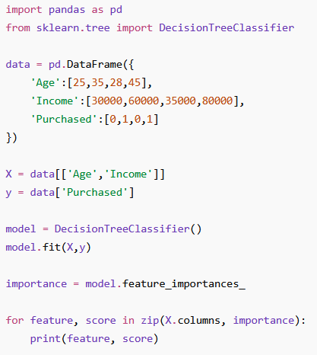
Feature importance usage in code

Slide 19
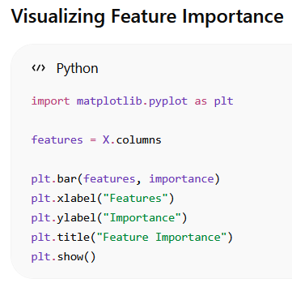

Slide 20
Assignment
Assignment: Automated Customer Loan Eligibility Approval Predictor
Objective
Develop a machine learning classification model that predicts whether a customer is eligible for a loan based on their demographic and financial information.
Problem Statement
Financial institutions receive thousands of loan applications daily. Manually reviewing each application is time-consuming and prone to inconsistencies.
Your task is to build an automated Loan Eligibility Approval Predictor that classifies applicants as:
Eligible (Approved)
Not Eligible (Rejected)
using historical customer data.

Slide 21
Dataset attributes
Dataset Attributes
Create or use a dataset with the following features:
Feature | Description
Gender | Male/Female
Age | Applicant Age
Marital_Status | Married/Single
Education | Graduate/Non-Graduate
Employment_Status | Employed/Self-Employed
Annual_Income | Yearly Income
Loan_Amount | Requested Loan Amount
Credit_Score | Credit Rating
Existing_Loan | Yes/No
Property_Area | Urban/Rural/Semiurban
Loan_Status | Approved/Rejected (Target)

Slide 22
Git project
git clone https://github.com/codingacharya/assignment6.git
Cd assignment6
Pip install –r requirements.txt
Streamlit run assignment61.py

